Slide 1
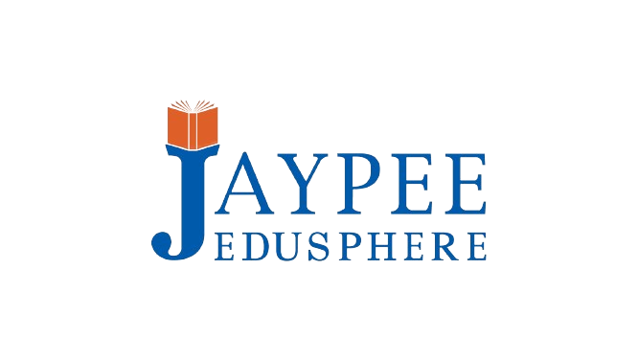


Unified MCP Framework for Context-Aware AI Agents in Software Development
Jaypee University of Information Technology
Department of Computer Science and Engineering and Information Technology
Major Project - I (18B19CI791) | AY 2025-26
End-Term Evaluation | December 2025.
Group No.: 1
Team Member (s)
Harsh Kumar (221031040)
Anjali Panwar (221030113)
Om Shree (221030410)
Naviya Tickoo (221030050)
Supervisor
Name: Dr. Aman Sharma
Designation: Assistant Professor (SG)

Slide 2
Outline
Introduction
Problem Statement
Objectives
Literature Review
Work Done (after Mid-Term Evaluation)
Project Design
Tools, Technologies and Languages
Dataset
Implementation
Experimental Results and Evaluation
Key Learnings
Work Contribution and Attendance
Supervisor Interactions
Future Work
Project Plan
References

Slide 3
Introduction
Modern software development increasingly relies on AI-powered tools that support code generation, testing, debugging and refactoring, improving speed and productivity[1]. However, developers still face workflow interruptions when switching between IDEs, browsers, consoles and platforms like GitHub, which causes loss of context and reduced efficiency [2]. Existing assistants remain limited because they cannot operate across environments seamlessly [3].
The Model Context Protocol (MCP) addresses this challenge by enabling secure communication and shared context between tools, allowing agents to support full workflows rather than isolated tasks [4][5]. This project develops a Unified MCP Framework connecting local files, the browser and GitHub through coordinated MCP servers.

Slide 4
Problem Statement
Problem Statement
Developers lose productivity when switching between IDEs, browsers, and GitHub, and current AI assistants cannot coordinate across these tools securely. Increasing risks like unauthorized tool use demand a safer, unified workflow.
This project proposes a Unified MCP Framework that securely integrates Desktop, Browser, and GitHub MCP servers to create a seamless, context-aware developer environment.

Slide 5
Objectives
Objective 1: Design and Develop Modular MCP Servers: Implement a Desktop MCP, Browser MCP, and GitHub MCP servers to ensure communication, interoperability, and scalability across different developer environments.
Objective 2: Develop the Unified Host MCP Server: Build a central server to orchestrate communication among the various MCP servers, providing a standardized protocol layer for multi-agent coordination.
Objective 3: Create a Full-Stack Platform: Develop an intuitive, agent-driven coding environment with a modern frontend, backend, and database to allow developers to interact with AI agents for tasks like coding, debugging, and workflow automation.

Slide 6
Literature Review
S. No. | Author & Paper Title [Citation] | Journal/ Conference (Year) | Tools/ Techniques/ Dataset | Key Findings/ Results | Limitations/ Gaps Identified
1. | Hao Song et al. Beyond the Protocol: Unveiling Attack Vectors in the MCP Ecosystem [6] | arXiv (2025) | Systematic study of attack vectors | - Proof-of-Concept (PoC) attacks against 5 LLMs | User study on a simulated MCP aggregator platform - Identified four new attack types: Tool Poisoning, Puppet, Rug Pull, and Malicious External Resources.
2. | MCPToolBench++: A Large Scale AI Agent Model Context Protocol MCP Tool Use Benchmark [7] | arXiv (2025) | N/A | MCPToolBench++: A large-scale benchmark with 1.5K question-answer pairs from over 4k MCP servers. | Evaluation metrics: Abstract Syntax Tree (AST) and Pass@K Accuracy. - Evaluated various SOTA LLMs, providing benchmark results for their MCP tool-use abilities.
3. | Nicola Croce & Tobin South TRIVIAL TROJANS: HOW MINIMAL MCP SERVERS ENABLE CROSS-TOOL EXFILTRATION OF SENSITIVE DATA [8] | arXiv (2025) | Proof-of-concept attack using a modified "Hello Weather" MCP server. | - Used basic Python and a free webhook service to exfiltrate data from a banking MCP server. | Demonstrated that even unsophisticated actors can easily create malicious MCP servers to steal sensitive data (e.g., bank balances) via cross-server attacks.
4. | Mohammed Mehedi Hasan et al. Model Context Protocol (MCP) at First Glance: Studying the Security and Maintainability of MCP Servers [9] | ACM Trans. Softw. Eng. Methodol. (2025) | Empirical study of 1,899 open-source MCP servers. | Hybrid analysis using SonarQube (general vulnerabilities) and mcp-scan (MCP-specific tool poisoning). | LLM-Jury to cluster issues. - 7.2% of servers contain general vulnerabilities (e.g., credential exposure) and 5.5% exhibit MCP-specific tool poisoning.

Slide 7
Literature Review (cont…)
S. No. | Author & Paper Title [Citation] | Journal/ Conference (Year) | Tools/ Techniques/ Dataset | Key Findings/ Results | Limitations/ Gaps Identified
5. | Vineeth Sai Narajala & Idan Habler Enterprise-Grade Security for the Model Context Protocol (MCP): Frameworks and Mitigation Strategies [10] | arXiv (2025) | Systematic threat modeling using the MAESTRO framework. | Proposal of a multi-layered security framework based on defense-in-depth and Zero Trust principles. | Translates theoretical risks into an actionable security framework for enterprises using MCP. - Details key threats like tool poisoning, data exfiltration, and server spoofing.
6. | Naveen Krishnan Advancing Multi-Agent Systems Through Model Context Protocol: Architecture, Implementation, and Applications [11] | Preprint (2025) | Reference architecture for MCP-enabled multi-agent systems. | Case studies in enterprise knowledge management, research, and problem-solving . | A new evaluation framework with benchmark tasks and datasets. - MCP can solve the "context retention problem" in multi-agent systems by standardizing context sharing.
7. | Jun Cui MCP Protocol's Capability in Integrating LLM Models: A Study within High-Tech AIOps R&D Processes [12] | Research Gate (2025) | Qualitative case study in an AIOps R&D lab. | Analysis of protocol logs, performance benchmarks, and interviews with 12 engineers. | MCP demonstrates strong compatibility and efficiency for integrating LLMs into AIOps workflows. - The protocol achieved sub-50ms latency in most test cases, sustaining 1,200 requests/second.
8. | Huihao Jing et al. MCP: Protecting MCP Safety via Model Contextual Integrity Protocol [13] | arXiv (2025) | N/A | MCIP: A proposed safety-enhanced version of MCP. | - MAESTRO framework for analysis. - MCIP-bench: A new benchmark and training dataset to identify unsafe behaviors.

Slide 8
Literature Review (cont…)
S. No. | Author & Paper Title [Citation] | Journal/ Conference (Year) | Tools/ Techniques/ Dataset | Key Findings/ Results | Limitations/ Gaps Identified
9. | Abul Ehtesham et al. A Survey Of Agent Interoperability Protocols [14] | arXiv (2025) | A survey and comparative analysis of four major agent protocols: MCP, ACP, A2A, and ANP. | Compares the protocols across architecture, discovery, security, and use cases. | MCP is ideal for tool invocation; ACP for messaging; A2A for enterprise task delegation; and ANP for open, decentralized networks.
10. | Alexandru-Andrei Avram et al., MCP-Orchestrated Multi-Agent System for Automated Disinformation Detection [15] | arXiv (2025) | Datasets: Kaggle "Fake News Detection", "Snopes" fact-checking, and Iffy News project. | The multi-agent ensemble achieved 95.3% accuracy and an F1 score of 0.964, significantly outperforming individual agents . | The system's dependence on web-sourced data creates risks if APIs fail or if search results are manipulated by disinformation campaigns .
11. | Vallikranth Ayyagari, Model Context Protocol for Agentic AI: Enabling Contextual Interoperability Across Systems [16] | IJCESEN (2025) | Architectural analysis of MCP . | Discussion of primitives such as tools, resources, prompts, and sampling. | Its design is flexible and vendor-agnostic, enhancing the context awareness of AI models and promoting a reusable ecosystem.
12. | Xinyi Hou et al., Model Context Protocol (MCP): Landscape, Security Threats, and Future Research Directions [17] | arXiv (2025) | Provides the first comprehensive analysis of the MCP ecosystem, detailing its architecture, components, and workflow . | Defines the MCP server lifecycle and identifies associated security risks, including name collision, installer spoofing, tool name conflicts, and configuration drift . | There is a lack of centralized security oversight and standardized authentication/authorization frameworks .

Slide 9
Work Done (after Mid-Term Evaluation)
Integration of System Components
Integrated Filesystem MCP, Browser MCP, and GitHub MCP servers into a unified multi-tool framework.
Implemented coordinated communication through the Host MCP Server for tool routing, execution, and response management.
Backend Implementation
Filesystem Server: Sandboxed operations, secure path validation, atomic file writes, and controlled directory management.
Browser Server: Playwright-based automation for search queries and webpage text extraction with enforced read-only interactions.
GitHub Server: secure API interactions through PyGitHub for repository inspection and file retrieval.

Slide 10
Work Done (after Mid-Term Evaluation)
Frontend Development
Developed a React + Vite interface for user interaction. Added structured tool execution trace visibility, responsive updates, and session-based state management.
Post Mid-Term Testing
Conducted functional testing of all MCP servers.
Verified Natural-Language-Based tool selection through Host MCP Server.
Performed frontend UI validation including error handling, tool traces, and stability checks.

Slide 11
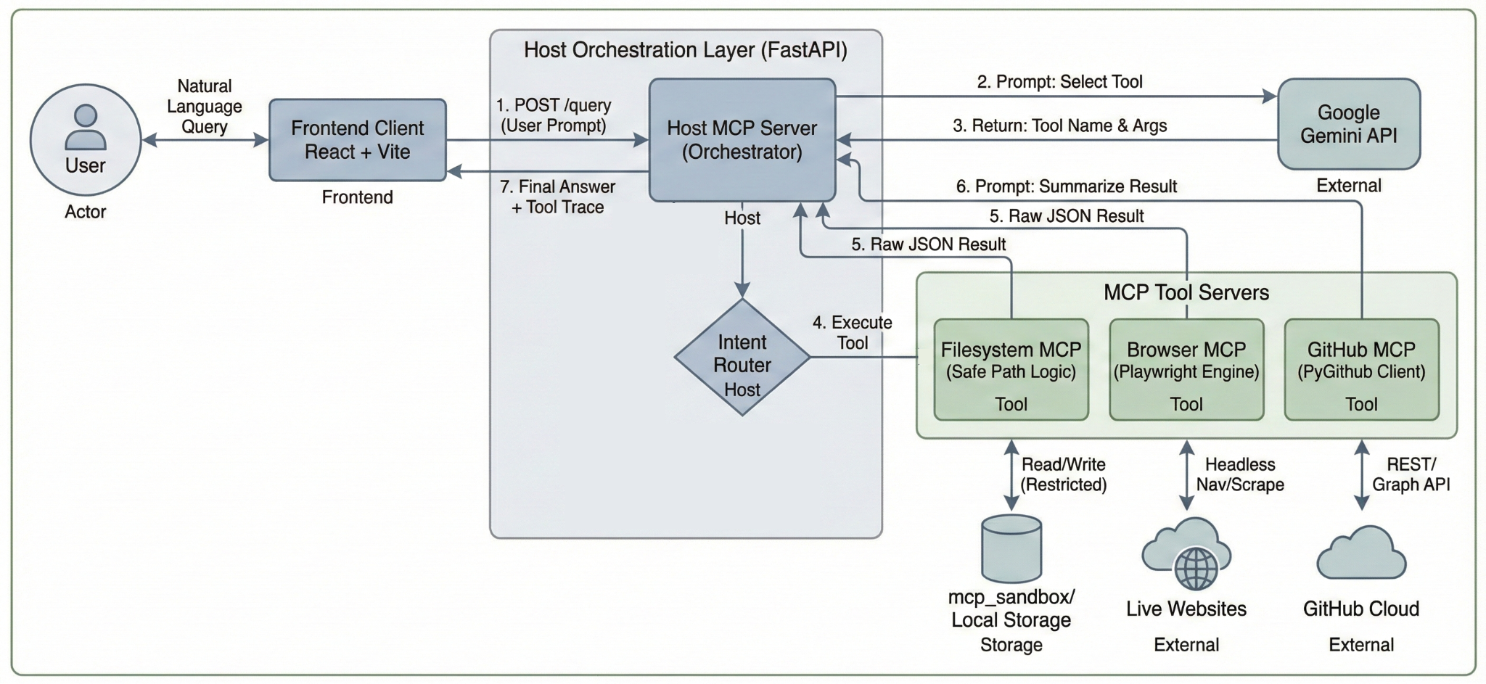
Project Design
The architecture features a central Host MCP Server that orchestrates user requests via JSON-RPC. It intelligently routes tasks to specialized Desktop, Browser, and GitHub agents, enabling seamless interaction with local databases and external APIs. This modular, layered design ensures secure context sharing and scalable AI integration.
Figure 1: System Architecture Diagram

Slide 12
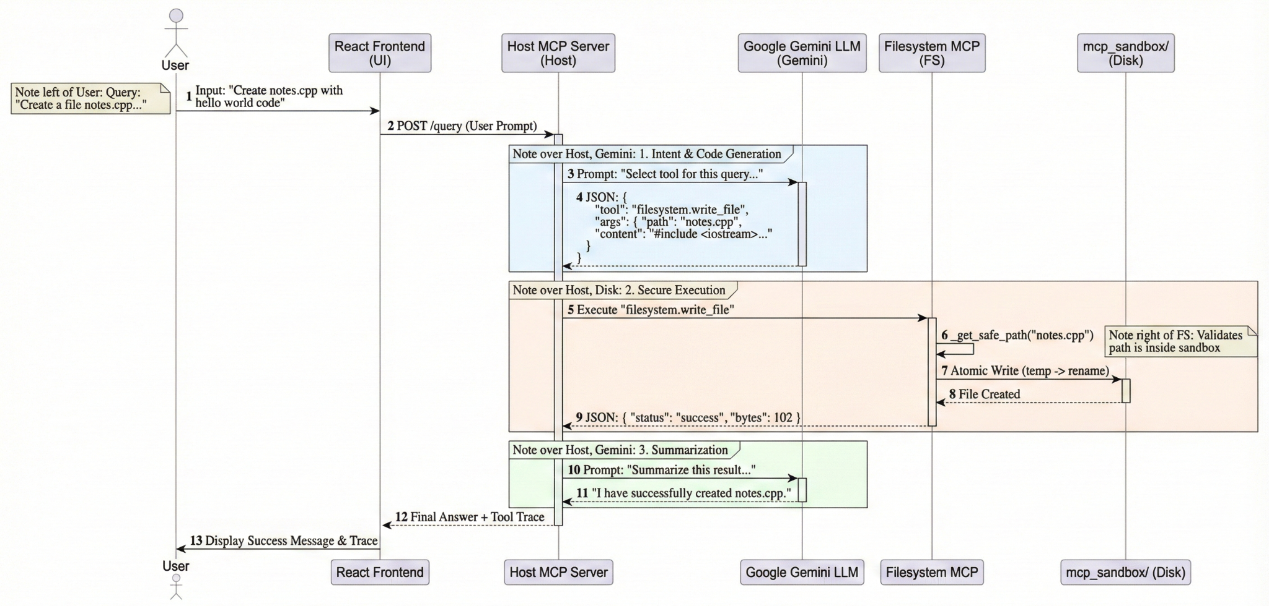
Project Design (cont…)
Figure 2: Flow of user prompts through Host MCP, connected MCP servers, and external services with results returned to the user.

Slide 13
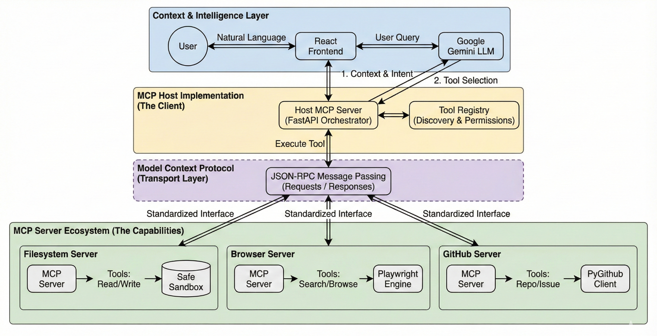
Project Design (cont…)
Figure 3: Conceptual Architecture of the Model Context Protocol (MCP)

Slide 14
Tools, Technologies and Languages
Backend & Orchestration
Python (FastAPI): High-performance asynchronous capabilities.
Pydantic & Uvicorn: Strict data validation and for stable API routing.
Frontend Interface
React 19 (Vite): Utilized for a modular, component-based UI for rapid development
Tailwind CSS: Utility-first styling to create a clean and responsive user interface.
AI & Automation Core
Google Gemini: Acts as the central intelligence for interpreting natural language user queries and summarizing tool outputs.
Playwright: Drives the Browser MCP with a headless Chromium engine for safe, read-only web automation .
PyGitHub: Facilitates authenticated, secure interaction with the GitHub API for repository management.

Slide 15
Tools, Technologies and Languages
Deployment & Environment
Local Execution: Designed for fully self-contained local deployment using Python virtual environments (.venv) for backend isolation and local Node.js servers for the frontend.
Version Control: Utilized GitHub for collaborative source code management, ensuring distinct tracking for backend servers and frontend logic.
Core Technologies
Model Context Protocol (MCP): Serves as the foundational standard for standardized tool discovery, creating a unifying layer between the AI model and external utilities .
Google Gemini API: Acts as the central reasoning engine, handling intent classification, dynamic tool routing, and response summarization .

Slide 16
Dataset
Unlike traditional ML models trained on static datasets, this framework processes live, unstructured data from the user's active workflow .
Local Filesystem (Sandboxed): Manages user-generated code files and directories securely confined within the mcp_sandbox environment to prevent unauthorized access .
External Repositories: Fetches real-time metadata, file contents, and commit histories directly from GitHub via authenticated API calls .
Web Resources: Processes live search results and webpage text extracted on-demand by the Browser MCP using Playwright .

Slide 17
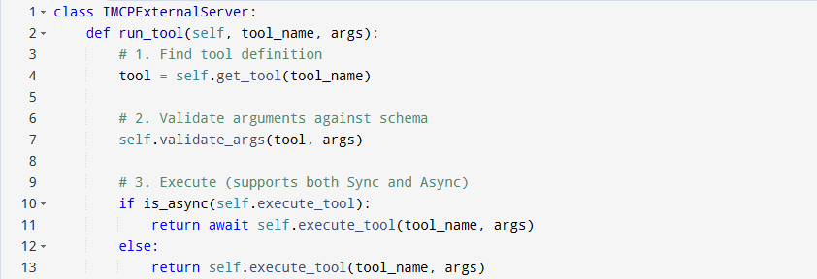
Implementation
MCP Core (The Foundation)
Role: Defines the standard MCPTool schema and the abstract base class IMCPExternalServer that all servers must inherit from.
Key Logic: The run_tool wrapper automatically handles validation and switches between sync/async execution .
Pseudocode Figure 1 : MCP Core Implementation

Slide 18
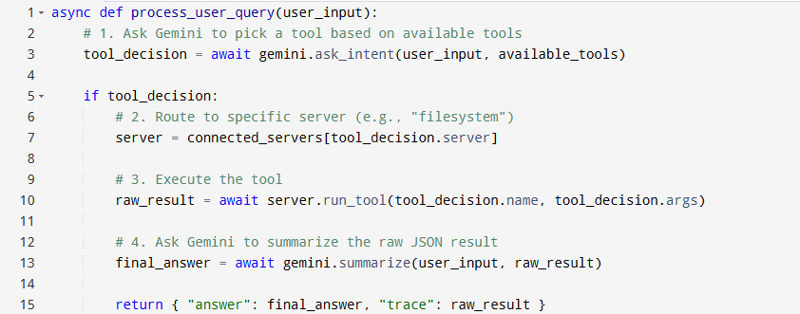
Implementation
Host MCP Server (The Orchestrator)
Role: The "Brain" of the system. It initializes connections to all tools and uses the LLM to route user queries .
Key Logic: The process_user_query pipeline: Intent -> Tool Selection -> Execution -> Summarization .
Pseudocode Figure 2 : Host MCP Server Implementation

Slide 19
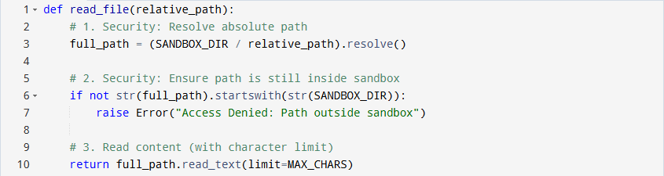
Implementation
Filesystem MCP (Secure Sandbox)
Role: Manages local files safely. Enforces strict isolation to the mcp_sandbox directory .
Key Logic: The _get_safe_path function is the security gatekeeper, blocking any path traversal attacks (../) .
Pseudocode Figure 3 : FileSystem MCP Server Implementation

Slide 20
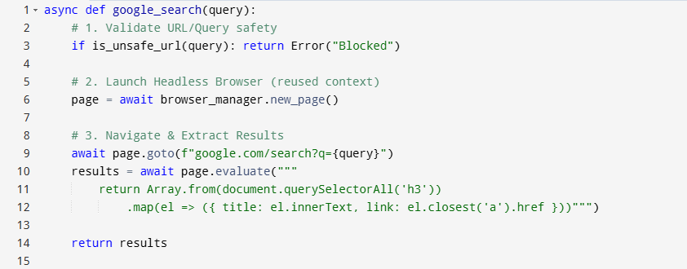
Implementation
Browser MCP (Automation)
Role: Performs safe, read-only web research. Blocks unsafe URLs (like localhost) to prevent SSRF attacks .
Key Logic: Uses a shared BrowserManager to reuse the Playwright instance for speed
Pseudocode Figure 4 : Browser MCP Server Implementation

Slide 21
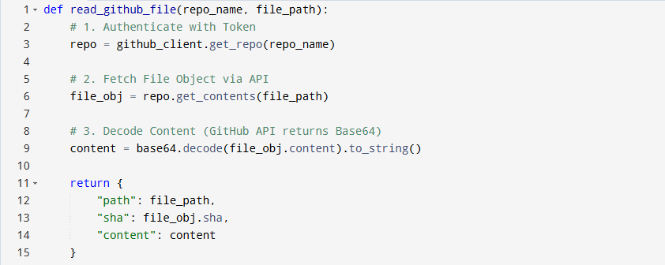
Implementation
GitHub MCP (Repository Access)
Role: Interacts with GitHub repositories via API. Handles authentication and base64 decoding transparently .
Key Logic: The read_file tool fetches content via the API and decodes it for the LLM .
Pseudocode Figure 5 : Github MCP Server Implementation

Slide 22
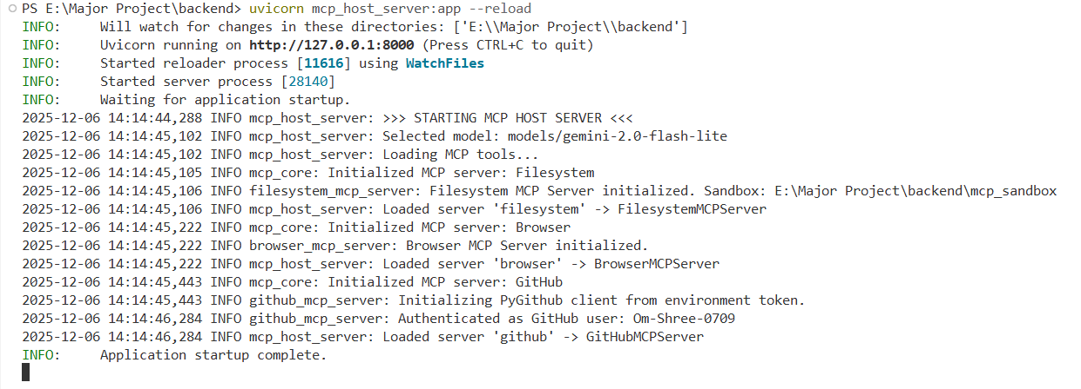
Experimental Results and Evaluation
System Initialization
Successful Orchestration: The Host MCP Server successfully initialized the FastAPI backend, establishing connections with the Google Gemini API for intent analysis .
Tool Registration: All three capability modules: Filesystem (Sandboxed), Browser (Playwright), and GitHub (PyGithub) were correctly loaded and registered, confirming the modular architecture is operational .
Figure 4 : System Initialization

Slide 23
Experimental Results and Evaluation (cont…)
Verified Working Scenarios
Filesystem Scenario:
Query: “Create a file notes.txt with content hello”
Tool Invoked: filesystem.write_file
Result: The system correctly interpreted the intent and created the file strictly within the secure sandbox .
GitHub Scenario:
Query: “Read the README file of my GitHub repo”
Tool Invoked: github.read_file
Result: The agent successfully authenticated, fetched the file, and returned the exact decoded text content .

Slide 24
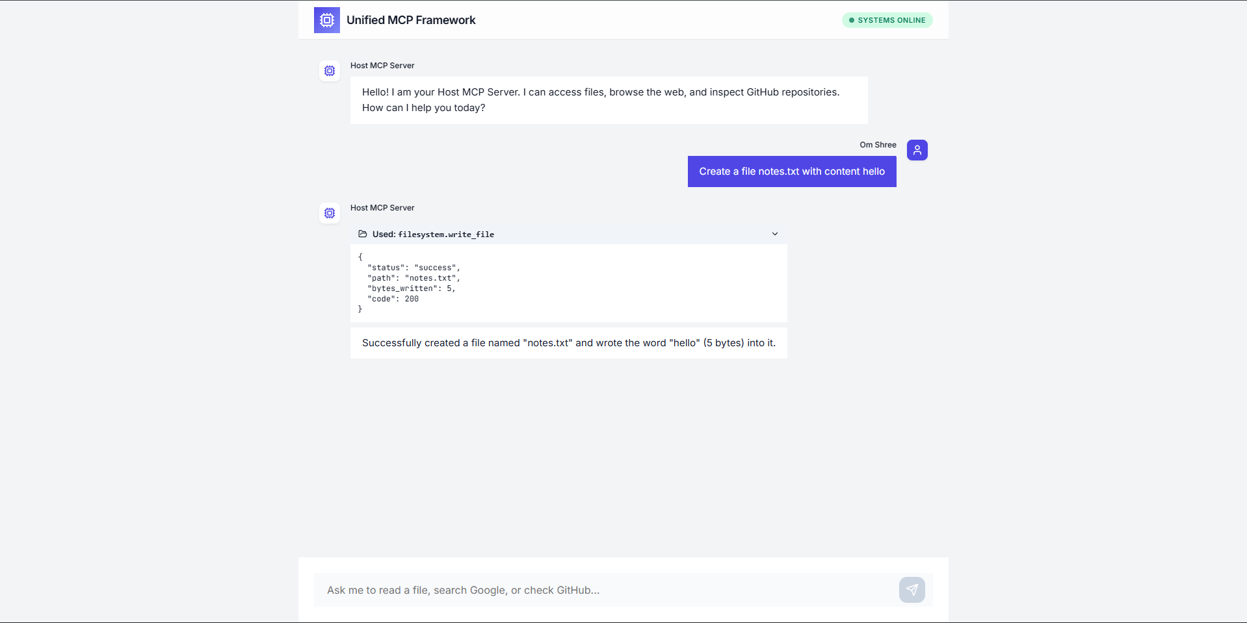
Experimental Results and Evaluation (cont…)
Filesystem Orchestration
The system analyzed the natural language command "Create a file notes.txt" and correctly mapped it to the filesystem.write_file tool .
Figure 5: MCP Frontend Tool Execution Output

Slide 25
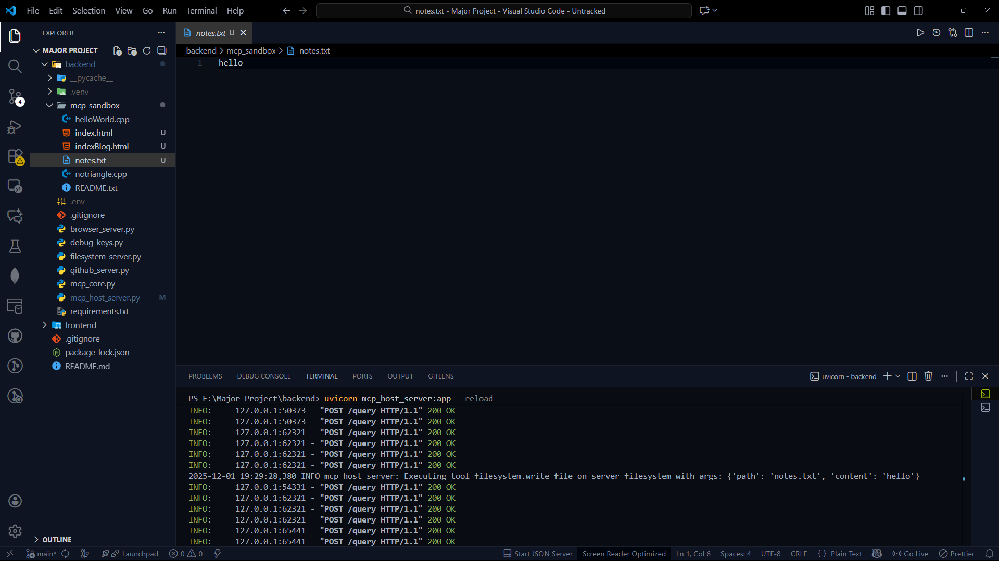
Experimental Results and Evaluation (cont…)
Backend Verification
The notes.txt file was physically created with the correct content, verifying that the tool server works as intended.
Figure 6: VS Code Sandbox File Creation

Slide 26
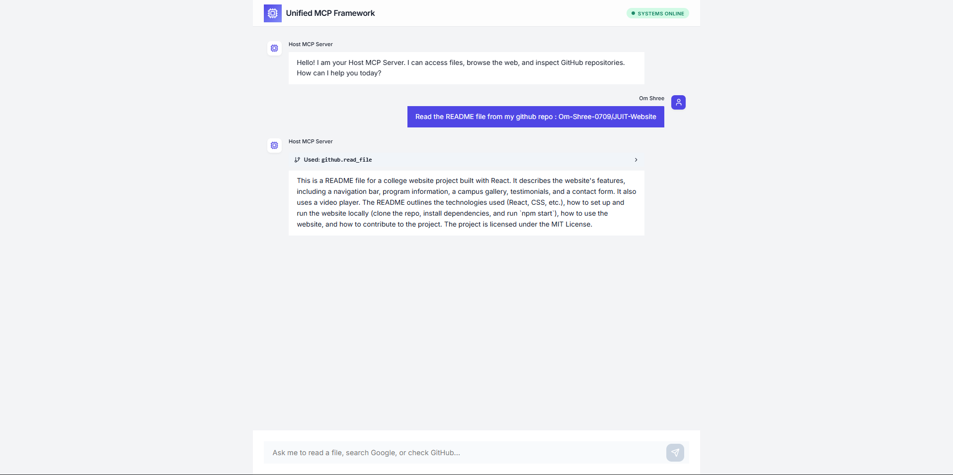
Experimental Results and Evaluation (cont…)
GitHub Integration
The agent successfully parsed a complex request containing a specific repository (Om-Shree-0709/JUIT-Website) and a target file (README.md) .
Figure 7: Tool Call (GitHub Read Operation)

Slide 27
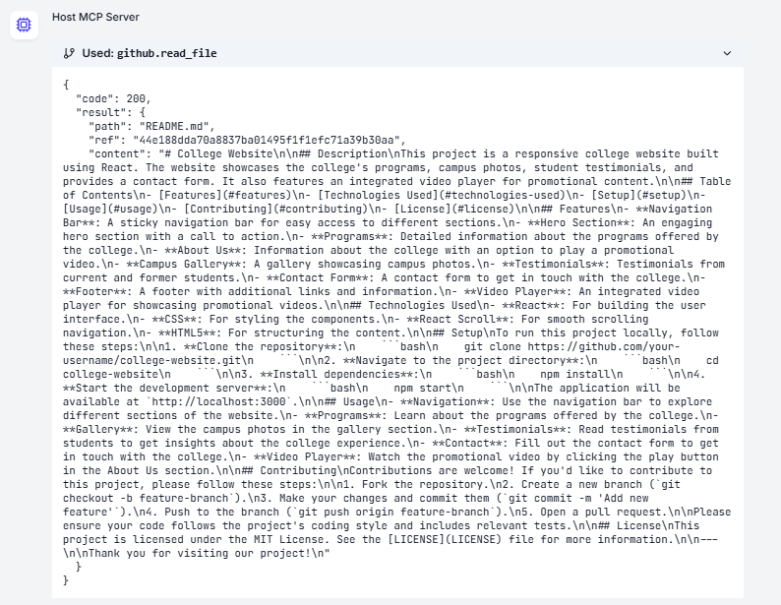
Experimental Results and Evaluation (cont…)
Data Retrieval & Transparency
The system authenticated with GitHub, fetched the requested file, and automatically decode the Base64 content into readable text .
Figure 8: Result (Decoded Repository Content)

Slide 28
Key Learnings
Protocol-Driven Orchestration: Mastered the implementation of the Model Context Protocol (MCP) to unify isolated developer environments (Filesystem, Browser, GitHub) into a single, cohesive workflow coordinated by a central Host Server .
Full-Stack AI Integration: Gained expertise in building a real-time, event-driven architecture that seamlessly connects a modern React frontend with asynchronous FastAPI backend services and Google Gemini, translating natural language into executable code actions .

Slide 29
Work Contribution and Attendance
GitHub Repository URL: https://github.com/Om-Shree-0709/Major-Project
Team Member | Roll No. | Work Done (provide complete details) | Work Contribution (%) | Lines of Code (if any) | Lab Attendance (%)
1. | 221031040 | Conducted literature survey on MCP ecosystem Implemented MVP for Desktop MCP Server Contributed to initial report writing. | 25% | 1000+ | 96.67%
2. | 221030113 | Studied research on MCP benchmarks and performance Prepared the literature review section Started developing the frontend interface (web UI design and workflows). | 25% | 1000+ | 97.66%
3. | 221030410 | Reviewed research papers on cross-server trust & interoperability Contributed to gap analysis Implemented MCP Server And Integrated with Host | 25% | 1000+ | 97.66%
4. | 221030050 | Contributed to frontend & design for website Read 4 key papers on MCP Literature review & key gaps | 25% | 1000+ | 90.63%

Slide 30
Supervisor Interactions (as mentioned in weekly log)
No. of Meetings with Supervisor: 13
Week No. | Duration | Remarks (as mentioned in the weekly log) | Incorporated (Yes/No)
1. | 13/08/2025 to 20/08/2025 | Continue literature survey and review research papers. | Yes
2. | 8/09/2025 to 15/09/2025 | Analyze key gaps from research papers and finalize literature survey section. | Yes
3. | 16/09/2025 to 21/09/2025 | Identify the potential gaps. Students should implement any one of the identified gaps. | Yes
4. | 22/09/2025 to 26/09/2025 | Start implementing from base paper. | No
5. | 29/09/25 to 05/10/25 | Find the base paper for research gaps and start the implementation . | No

Slide 31
Supervisor Interactions (cont…)
Week No. | Duration | Remarks (as mentioned in the weekly log) | Incorporated (Yes/No)
6. | 19/10/25 to 26/10/25 | Complete Browser Implementation. | Yes
7. | 26/10/25 to 10/11/25 | Complete your Implementation as discussed . | Yes
8. | 02/11/25 to 09/11/25 | Implement the changes as discussed . | Yes
9. | 09/11/25 to 16/11/25 | Complete the Integration Part . | Yes
10. | 16/11/25 to 23/11/25 | Complete the Integration Part . | Yes

Slide 32
Supervisor Interactions (cont…)
Week No. | Duration | Remarks (as mentioned in the weekly log) | Incorporated (Yes/No)
11. | 23/11/25 to 30/11/25 | Work on connection with main functional UI and Backend . Work on Report. | Yes
12. | 30/11/25 to 07/12/25 | Work on connection of MCP server (components) . | Yes
13. | 04/12/25 to 11/12/25 | Implement the changes as discussed regarding Report , Presentation , video . | Yes

Slide 33
Future Work
Server Unification:
Complete the integration of Desktop, Browser, and GitHub MCP servers into the central Host Orchestrator to establish a single, cohesive backend logic .
Deployment & Validation:
Deploy the fully integrated system (Frontend + Orchestrator + Tools) for extensive end-to-end testing.
Validate the framework's stability and security across complex, multi-step developer workflows .

Slide 34
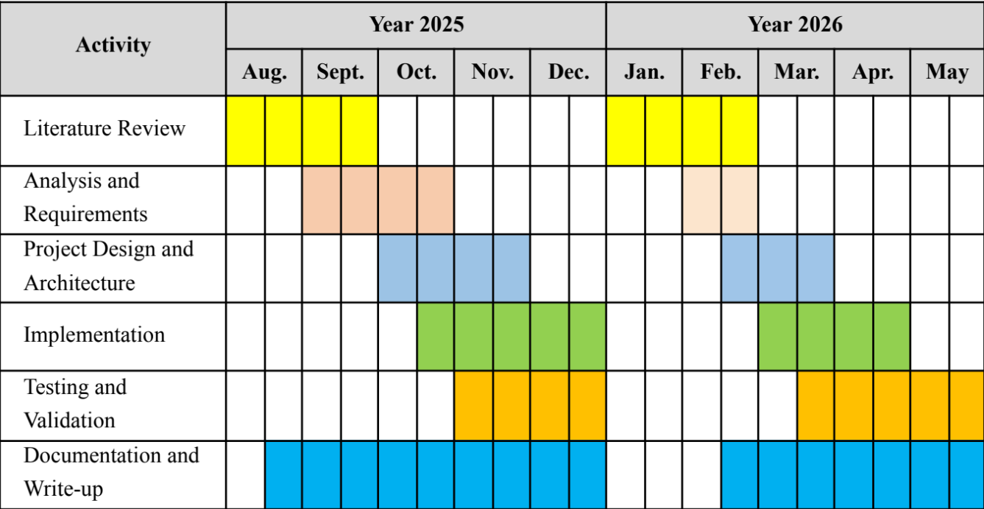
Project Plan

Slide 35
References
[1] F. Fiegel, “Introducing Model Context Protocol (MCP),” Glama – MCP Hosting Platform, 2024. https://glama.ai/blog/2024-11-25-model-context-protocol-quickstart
[2] O. Shree, “Constrained Tool Design for LLMs: Model Context Protocol in Time Travel Debugging,” Glama – MCP Hosting Platform, 2025. https://glama.ai/blog/2025-10-27-agentic-debugging-with-time-travel-the-architecture-of-certainty
[3] O. Shree, “Evaluating Tool-Oriented Architectures for AI Agents,” Glama – MCP Hosting Platform, Sep. 02, 2025. https://glama.ai/blog/2025-09-02-comparing-mcp-vs-lang-chainre-act-for-chatbots#developer-ergonomics.
[4] F. Fiegel, “Why AI Agents Need a New Protocol,” Glama – MCP Hosting Platform, 2025. https://glama.ai/blog/2025-06-06-mcp-vs-api
[5] O. Shree, “Leveraging the MCP Registry for Structured Server Definition and Discovery,” Glama – MCP Hosting Platform, 2025. https://glama.ai/blog/2025-10-26-the-model-context-protocol-registry-standardizing-server-discovery-in-a-decentralized-ecosystem

Slide 36
References
[6]H. Song et al., “Beyond the Protocol: Unveiling Attack Vectors in the Model Context Protocol Ecosystem,” arXiv.org, 2025. https://arxiv.org/abs/2506.02040
[7]S. Fan, X. Ding, L. Zhang, and L. Mo, “MCPToolBench++: A Large Scale AI Agent Model Context Protocol MCP Tool Use Benchmark,” arXiv.org, 2025. https://arxiv.org/abs/2508.07575 .
[8]N. Croce and T. South, “Trivial Trojans: How Minimal MCP Servers Enable Cross-Tool Exfiltration of Sensitive Data,” arXiv.org, 2025. https://arxiv.org/abs/2507.19880.
[9]M. M. Hasan, H. Li, E. Fallahzadeh, R. G. Krishnan, B. Adams, and A. E. Hassan, “Model Context Protocol (MCP) at First Glance: Studying the Security and Maintainability of MCP Servers,” arXiv.org, 2025. https://arxiv.org/abs/2506.13538
[10]N. V. Sai and I. Habler, “Enterprise-Grade Security for the Model Context Protocol (MCP): Frameworks and Mitigation Strategies,” arXiv.org, 2025. https://arxiv.org/abs/2504.08623
[11]N. Krishnan, “Advancing Multi-Agent Systems Through Model Context Protocol: Architecture, Implementation, and Applications,” arXiv.org, 2025. https://arxiv.org/abs/2504.21030

Slide 37
References (cont…)
[12]J. Cui, “MCP Protocol’s Capability in Integrating LLM Models: A Study within High-Tech AIOps R&D Processes,” May 17, 2025. https://www.researchgate.net/publication/391837315_MCP_Protocol
[13]H. Jing et al., “MCIP: Protecting MCP Safety via Model Contextual Integrity Protocol,” arXiv.org, 2025. https://arxiv.org/abs/2505.14590
[14]A. Ehtesham, A. Singh, G. K. Gupta, and S. Kumar, “A survey of agent interoperability protocols: Model Context Protocol (MCP), Agent Communication Protocol (ACP), Agent-to-Agent Protocol (A2A), and Agent Network Protocol (ANP),” arXiv.org, 2025. https://arxiv.org/abs/2505.02279
[15]A.-A. Avram, A. Groza, and A. Lecu, “MCP-Orchestrated Multi-Agent System for Automated Disinformation Detection,” arXiv.org, 2025. https://arxiv.org/abs/2508.10143 (accessed Sep. 24, 2025).
[16]V. Ayyagari, “Model Context Protocol for Agentic AI: Enabling Contextual Interoperability Across Systems,” International Journal of Computational and Experimental Science and Engineering, vol. 11, no. 3, Aug. 2025, doi: https://doi.org/10.22399/ijcesen.3678.
[17]X. Hou, Y. Zhao, S. Wang, and H. Wang, “Model Context Protocol (MCP): Landscape, Security Threats, and Future Research Directions,” arXiv.org, 2025. https://arxiv.org/abs/2503.23278

Slide 38

Thanks.

